Slide 1
PYTHON FOR DATA ANALYTICS PROJECT 2023 - MARCH DAF
QA- Unicorn Companies Private companies with a valuation over $1 billion as of March 2022, including each company's current valuation, funding, country of origin, industry, select investors, and the years they were founded and became unicorns.
Recommended Analysis
Which unicorn companies have had the biggest return on investment?
How long does it usually take for a company to become a unicorn? Has it always been this way?
Which countries have the most unicorns? Are there any cities that appear to be industry hubs?
Which investors have funded the most unicorns

Slide 2
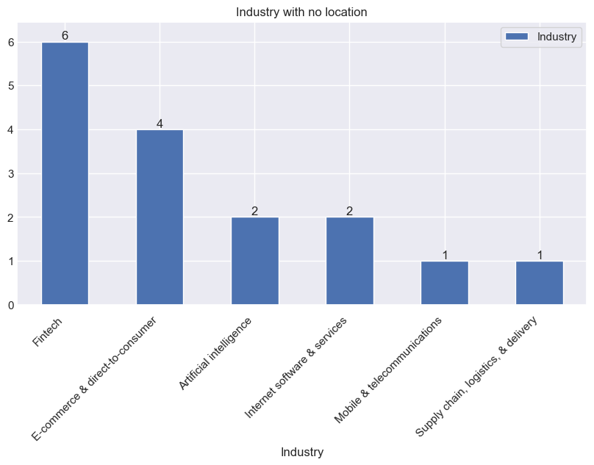
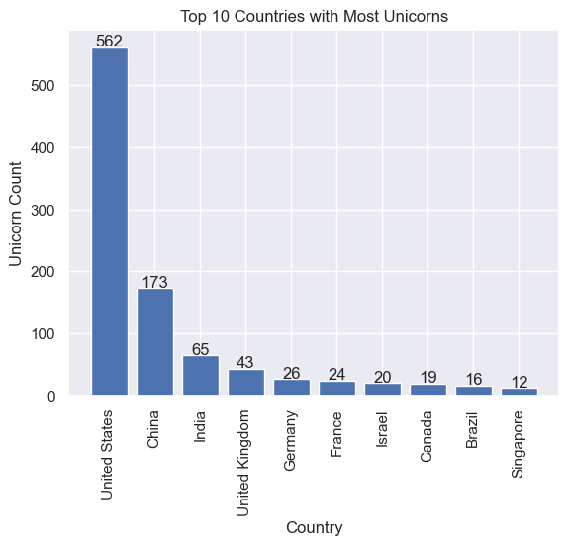
Industry with no location/Distribution of unicorns by country?

Slide 3
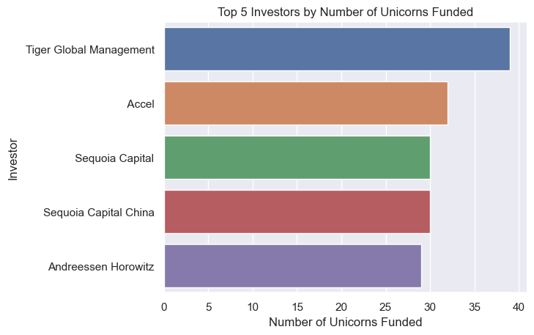
Which investors have funded the most unicorns?

Slide 4
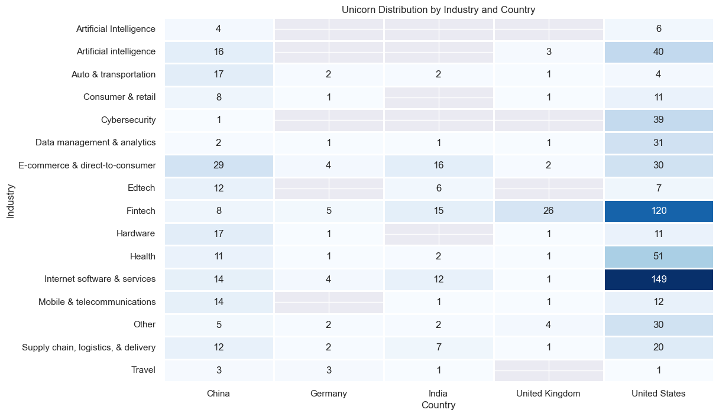
Which countries have the most unicorns? Are there any cities that appear to be industry hubs?

Slide 5
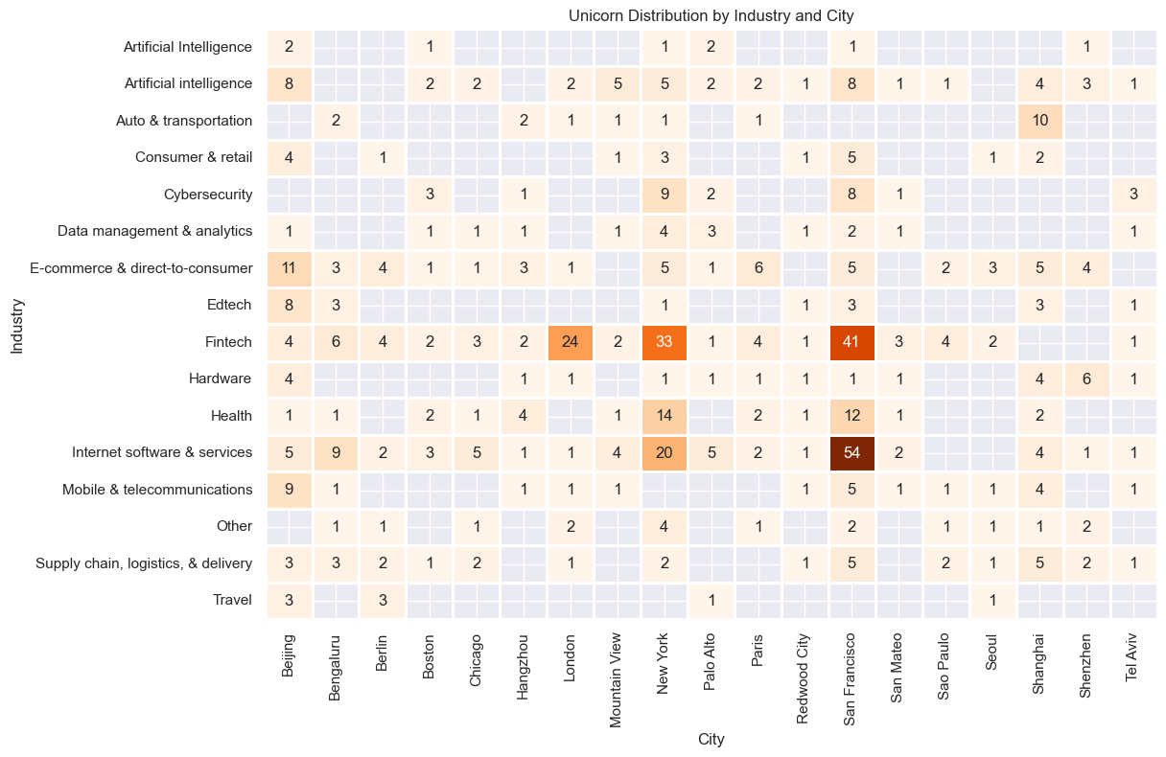
Count unicorns by city?

Slide 6
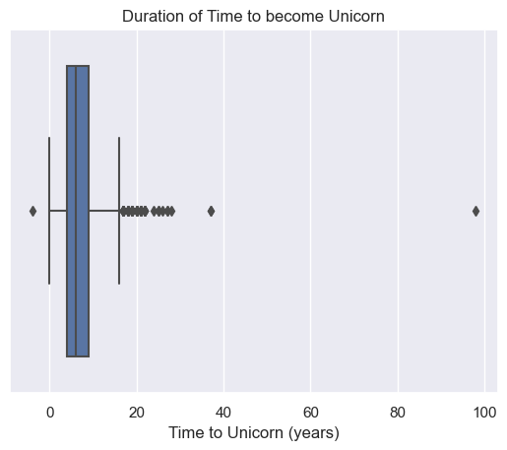
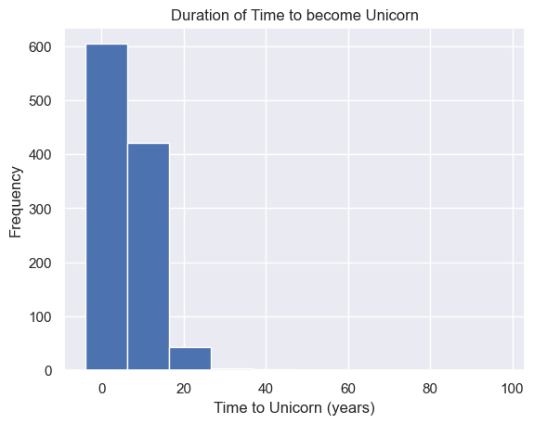
How long does it usually take for a company to become a unicorn? Has it always been this way

Slide 7
Recommendation
Some recommendations to help unicorn companies in creating good business models and making decisions that will focus on companies with high growth potential, diversify an investment portfolio, and prioritize companies with experienced leadership teams include;
Focus on countries with high average funding and a large number of unicorns, such as the United States and China. This will increase the chances of investing in startups with high growth potential and experienced leadership teams.
Consider investing in startups with a positive relationship between funding and valuation, as this indicates that the startup has a strong business model and is likely to have high growth potential.
Diversify the investment portfolio by investing in startups from different countries, industries, and stages of development. This will help spread risk and increase the chances of finding successful startups.
Prioritize startups with experienced leadership teams, as this is a key factor in the success of a startup. Look for founders and executives with a proven track record of success in their industry.
Use data analytics to identify trends and patterns in the startup ecosystem, such as emerging industries or technologies. This can help identify startups with high growth potential before they become widely known.
Build relationships with other investors and industry experts to share knowledge and insights about the startup ecosystem. This can help identify promising startups and provide valuable feedback to portfolio companies.

